Slide 1
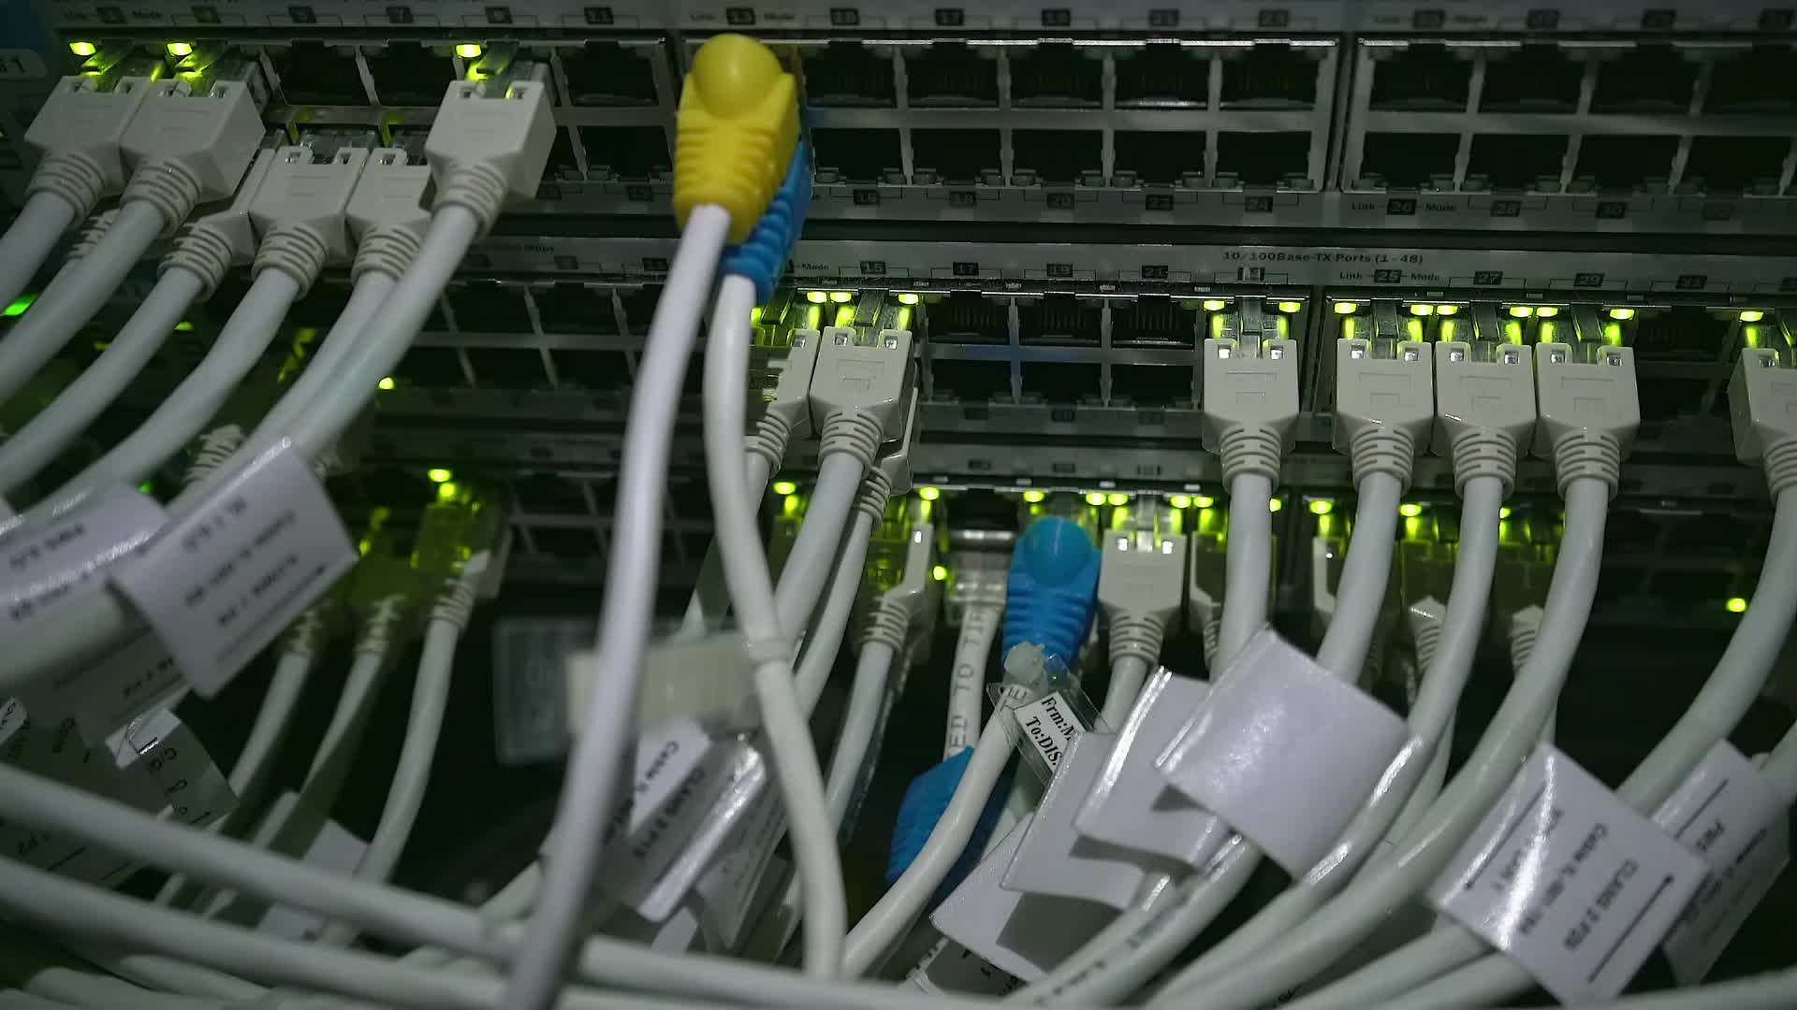
Gui for data mining applications using streamlit python library
Prepared By: Engr.HAMZA

Slide 2

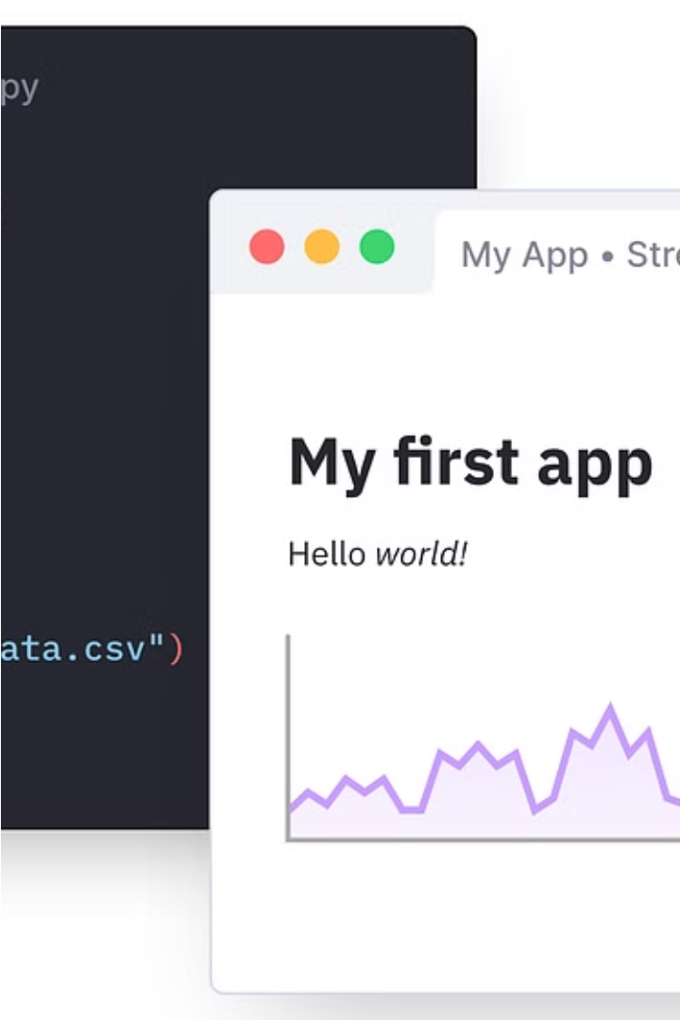

Introduction to Streamlit
Streamlit is a powerful open-source Python library that allows you to create interactive, data-driven web applications with minimal code. It simplifies the process of building and deploying AI and data science projects.

Slide 3

What is Streamlit?
Streamlit is an open-source Python library that enables the rapid development of interactive, data-driven web applications. It allows data scientists and developers to create dynamic visualizations and dashboards with minimal coding, making it an ideal tool for prototyping and deploying AI and data science projects.
At its core, Streamlit provides a simple yet powerful set of components that can be easily integrated into Python scripts, allowing users to build stunning web applications without the need for extensive web development knowledge.

Slide 4

Benefits of using Streamlit
Rapid Prototyping: Streamlit's simple syntax allows for quick development of data-driven apps, accelerating the pace of innovation.
Accessibility: Streamlit applications can be easily shared and deployed, making them accessible to a wide audience.
Powerful Visualizations: Streamlit provides a rich set of built-in components for creating visually stunning and interactive dashboards.

Slide 5
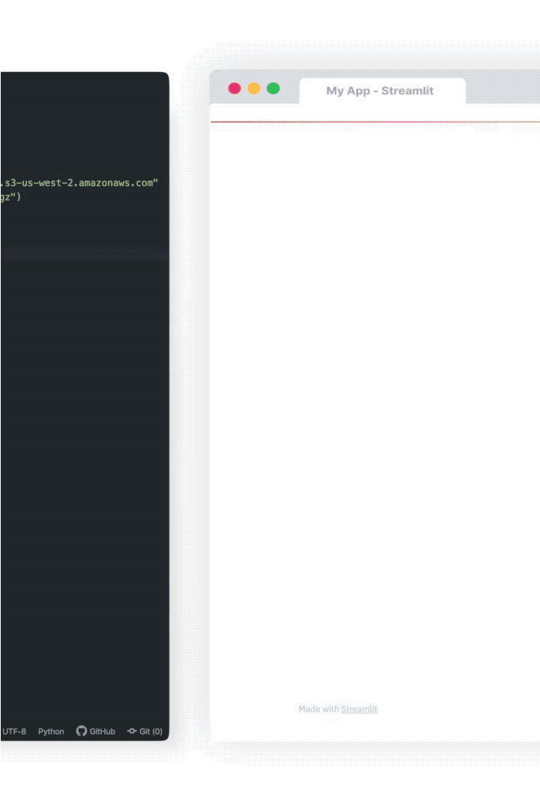
Installing Streamlit
Getting started with Streamlit is easy. You can install the library using the popular Python package manager, pip. Simply open your terminal or command prompt and run the following command:
pip install streamlit
Once the installation is complete, you're ready to start building your first Streamlit application.

Slide 6

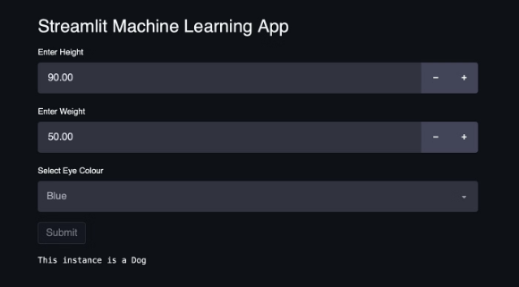
Creating a Streamlit App
To create a Streamlit app, you'll start by writing a Python script that leverages Streamlit's built-in components and functions. This script will define the layout, interactivity, and data visualization elements of your app.
Streamlit makes it easy to build interactive web applications with just a few lines of code, without the need for extensive web development experience.

Slide 7



Running the Streamlit Script
Write the Script
Install Streamlit
Run the Script
Begin by creating a Python script that leverages Streamlit's components and functions to define your app's layout, interactivity, and data visualization.
Ensure you have Streamlit installed on your system by running the command
pip install streamlit
in your terminal or command prompt.
In your terminal, navigate to the directory containing your Streamlit script and run the command
streamlit run your_script.py
to launch your app.

Slide 8
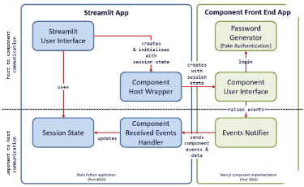
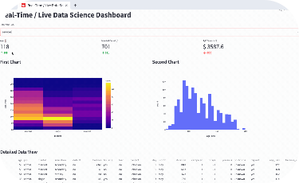

Building the UI with Streamlit Components
Streamlit's Building Blocks
Flexible App Layout
Extending Functionality
With Streamlit, you can easily structure your app's layout by arranging components in columns, rows, and custom grid systems to create visually appealing and intuitive interfaces.
Streamlit provides a rich set of pre-built UI components such as text inputs, buttons, dropdowns, and charts that allow you to quickly assemble engaging user interfaces.
Streamlit also enables you to build your own custom components, allowing you to extend the library's capabilities and tailor the UI to your specific needs.

Slide 9
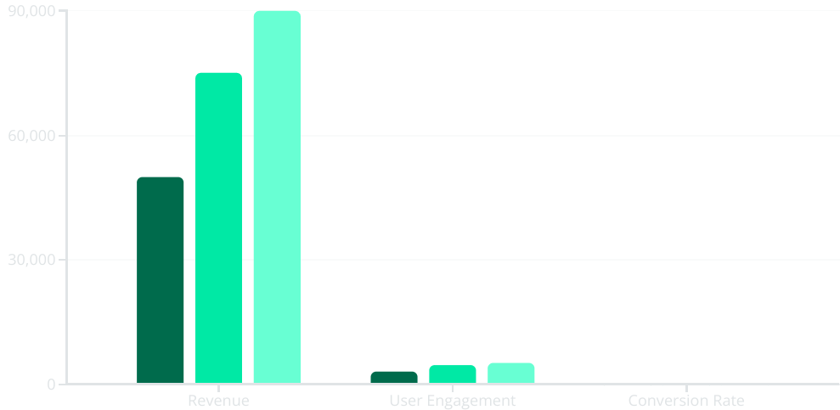
Handling user input and data
Streamlit makes it easy to handle user input and integrate data sources into your applications. With built-in components like text input, sliders, and file uploaders, you can quickly build interactive user experiences that respond to user actions.
Q1
Q2
Q3
The chart above demonstrates how you can visualize key business metrics over time, using Streamlit's powerful charting capabilities to help stakeholders understand the impact of your application.

Slide 10
Advanced Streamlit Features
Customization
Interactivity
Deployment Options
Streamlit empowers developers to create custom components, layouts, and styling to tailor the user experience to their specific needs. This allows for truly unique and branded applications.
Beyond static visualizations, Streamlit supports rich interactivity through features like callbacks, state management, and live-updating charts. Users can explore data and content in engaging ways.
Streamlit apps can be deployed to a variety of cloud platforms, including Heroku, AWS, and Google Cloud. This flexibility enables teams to host their applications securely and at scale.

Slide 11
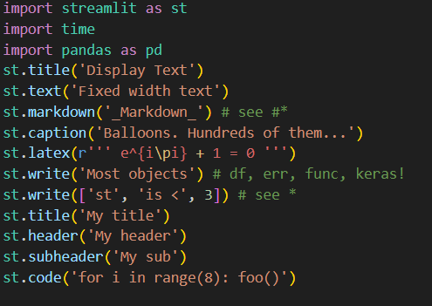
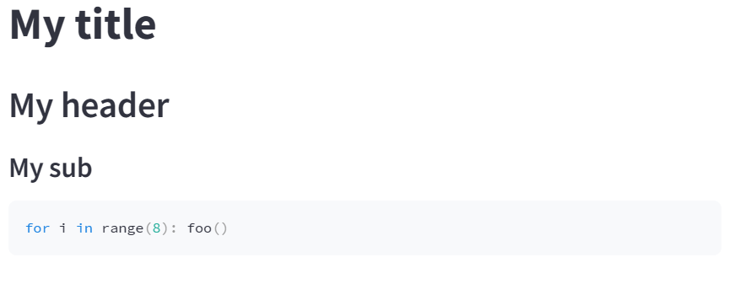
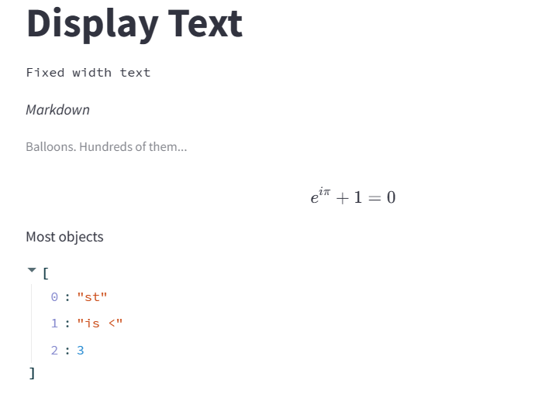

Slide 12
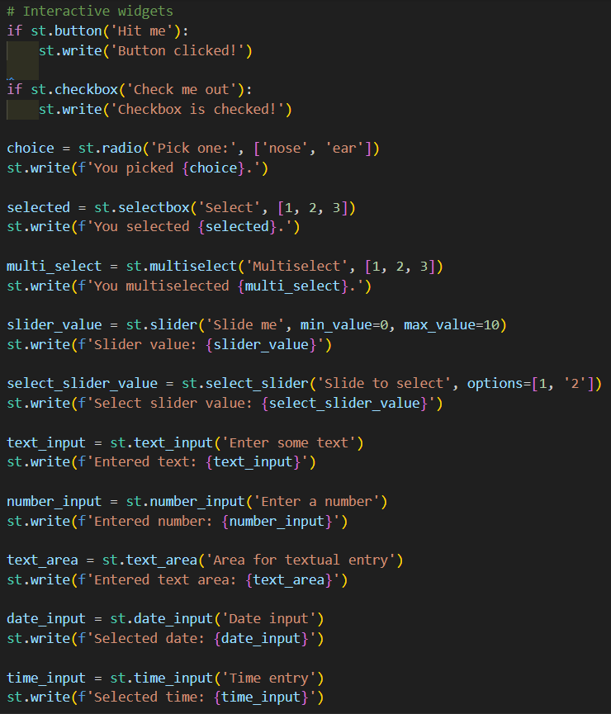
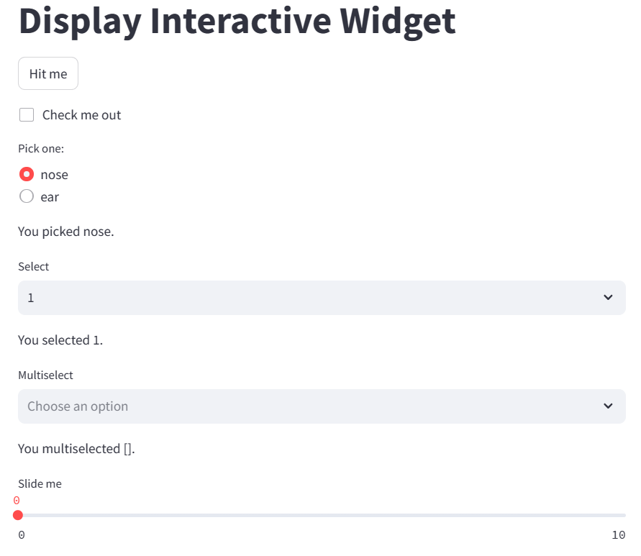

Slide 13
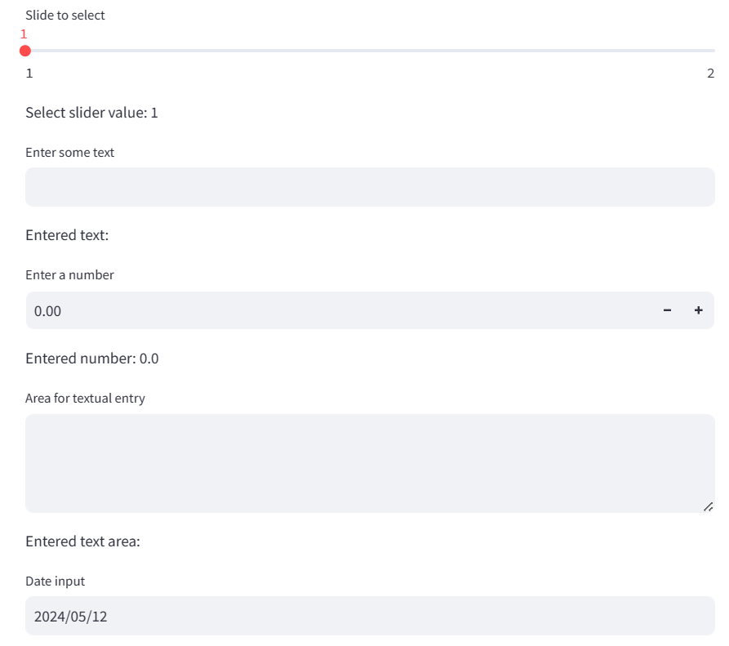

Slide 14
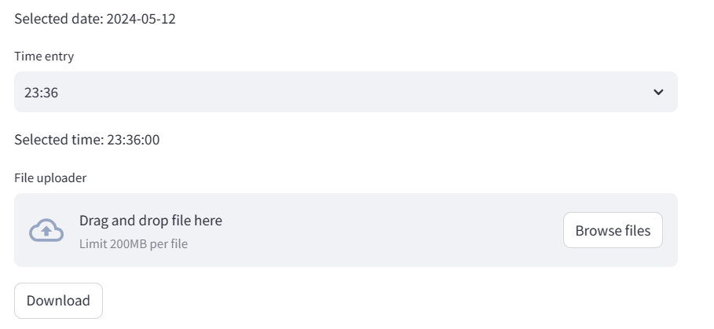
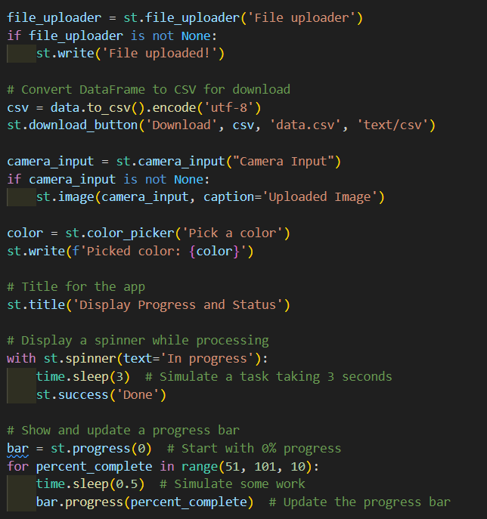
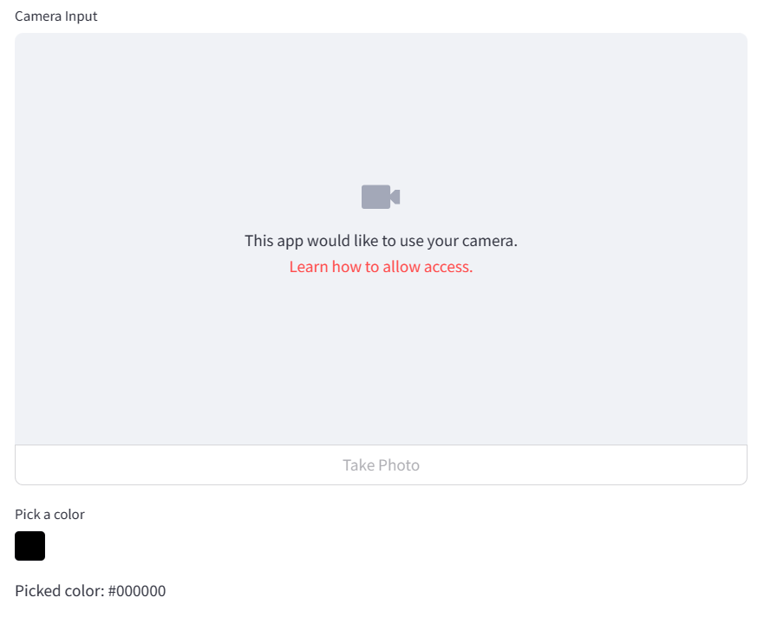

Slide 15
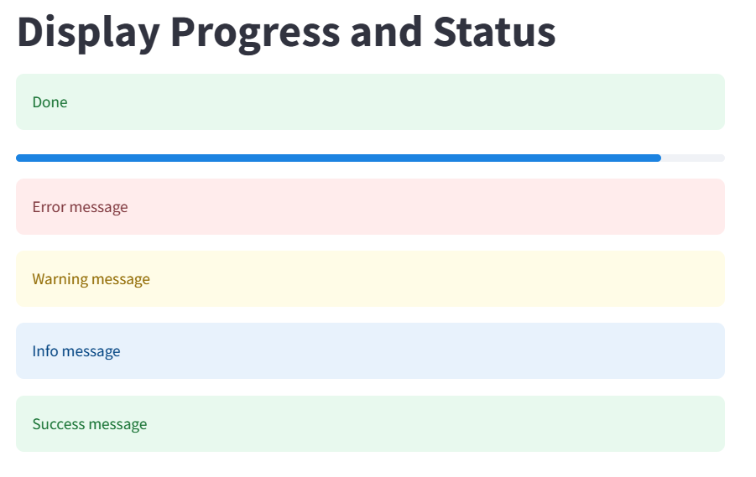

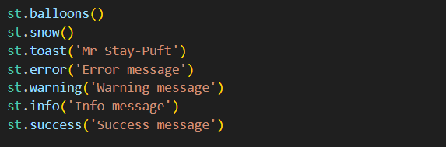

Slide 16
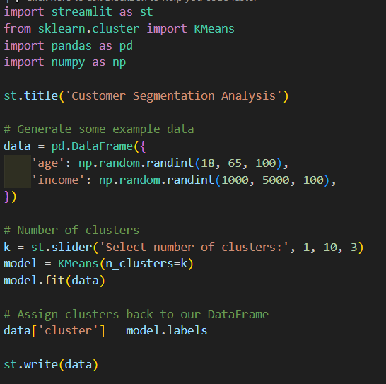
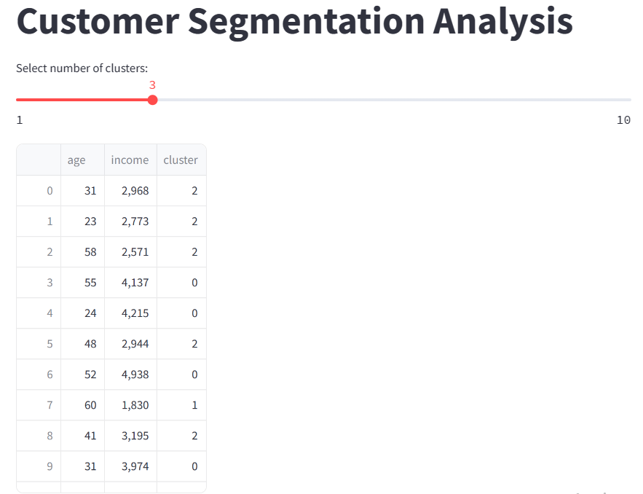

Slide 17
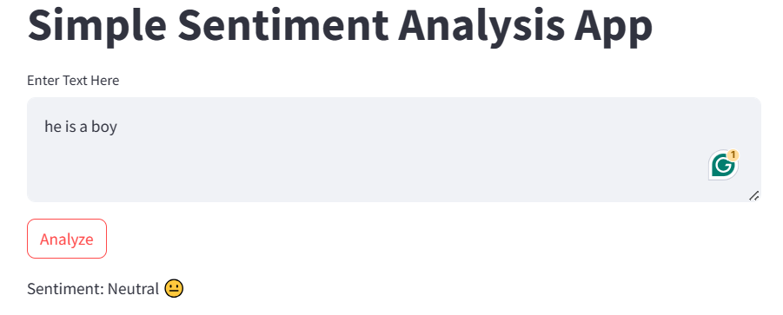
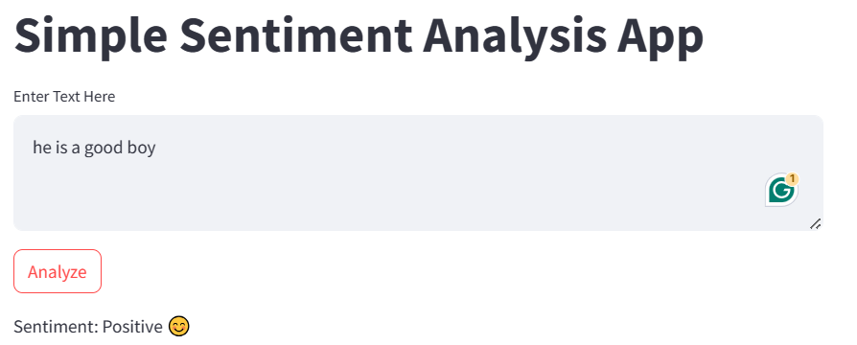
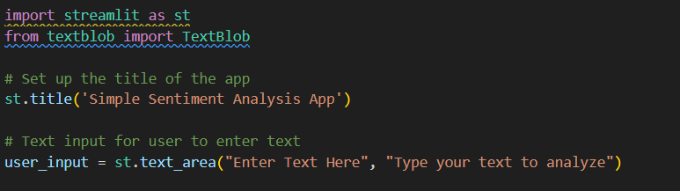
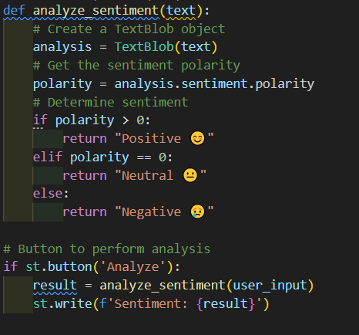
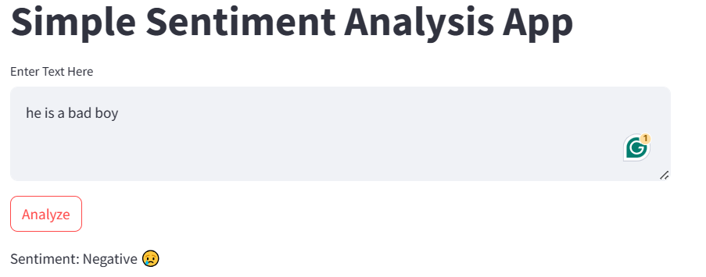

Slide 18
TASKS
Task 1: Web Scraping and Text Analysis
Develop a Python script to scrape textual data from websites and perform sentiment analysis on this data. This could involve analyzing customer reviews, forum discussions, or news articles.
Requirement Steps:
Use requests and BeautifulSoup for web scraping to extract data.
Clean and preprocess the data using libraries like nltk or spacy.
Perform sentiment analysis using a pre-trained model from textblob or build your own classifier with scikit-learn.
Visualize the results using matplotlib or seaborn.

Slide 19
TASKS
Task 2: Analyzing Publicly Available APIs
Use publicly available APIs (like Twitter API, OpenWeatherMap, or others) to fetch data and analyze specific trends or patterns.
Requirements Steps:
Fetch data from APIs using the requests library.
Analyze data to find trends (e.g., frequency of specific words on Twitter, changes in weather patterns).
Plot data using visualization libraries to interpret these trends.

Slide 20
TASKS
Task 2: Data Mining From Files
Perform data mining from a collection of local files (like logs, text files, or CSVs) to extract meaningful information without using a database.
Requirements Steps:
Read data from various file formats using Python (csv, open, pandas).
Process and analyze data to detect anomalies, patterns, or generate summaries.
Use statistical methods or machine learning models to derive insights.
Visualize the findings using appropriate Python libraries.

